Slide 1
Welcome to the USCG Pay & Personnel Center

Slide 2
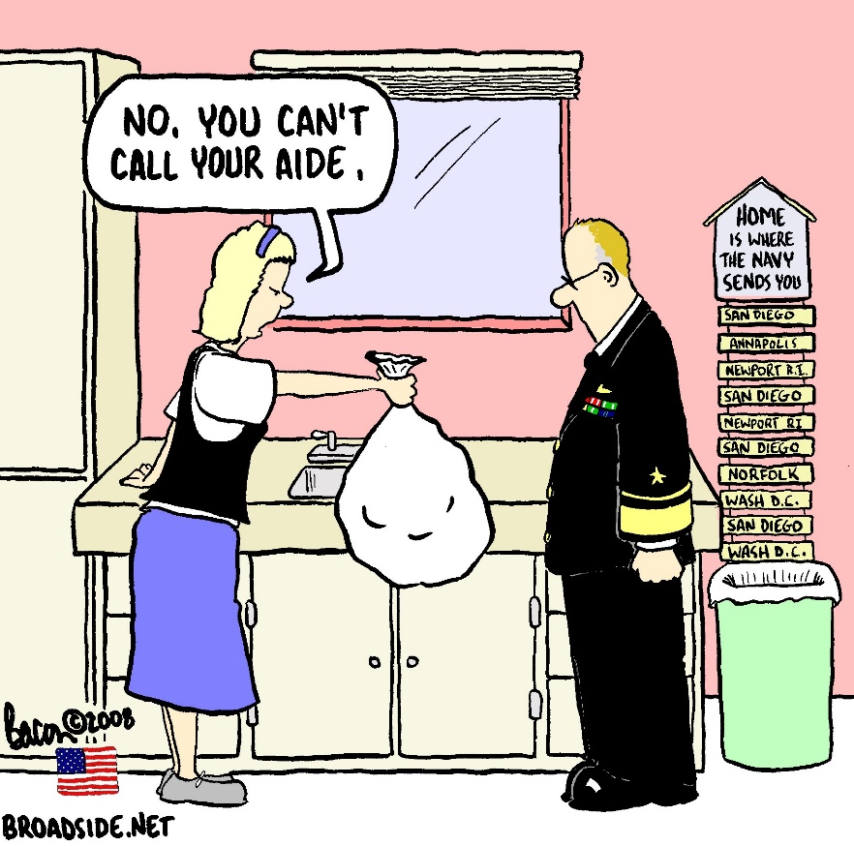
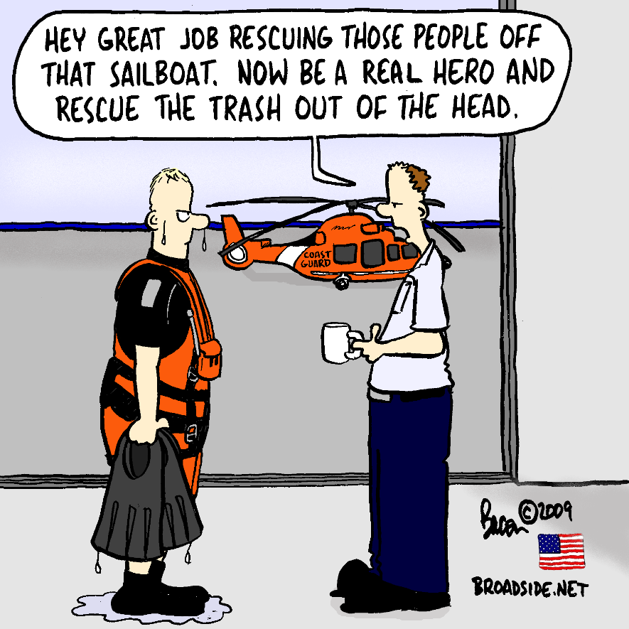

Slide 3
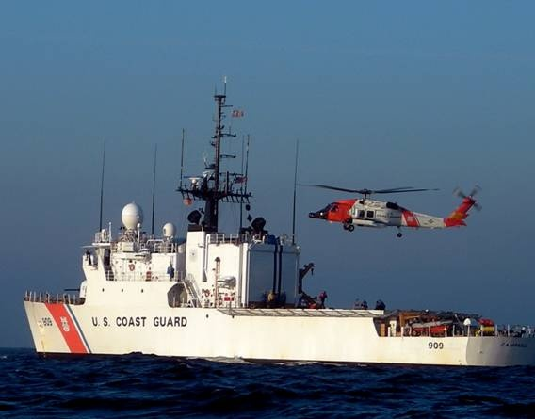
PPC Mission
We provide accurate, timely and efficient military pay and personnel services to our customers.
We worry so they don’t have to!

Slide 4
Why the Coast Guard in Kansas?
Frank Carlson Federal Building
1979 Established the Military Pay Center in Riverdale, MD
1982 Moved to Topeka, KS from Riverdale, MD

Slide 5
Growth
2021
2020
ETS & FSMS
2018
QA Tools
2015
BRS
2014
HCMS Global Pay
2012
PHS Retiree Payroll
2010
HCMA Technology Refresh
2009
Direct Access Portal
2008
Web TPAX
2007
Imaging & Audits
2005
RAS Global Pay
2004
YN & Reserve Training Began
2000
Full Direct Access Implementation
1999
Direct Access
1996
NOAA Payroll
1994
Travel Centralization
1993
Enlisted Adv. & SWEs; Prisoner Appellate Admin Centralization
1986
Retired Affairs; Reserves on PMIS/JUMPS
All Active Duty Payroll under JUMPS

Slide 6
Operations Snapshot
$400 Thousand Operating Budget
$100 Million Annual Impact to Local Economy
Current Positions
Civilian 163
Military 61
Total 224

Slide 7
Production
Total Payroll $5.3 B
Active/Reserve ($2.9 B)
Retirees ($2.4 B)
Travel Claim Settlements $173 M
Service Wide Exam Process, Call Center, Procedure Guides, Garnishments, Fin/Audit USPHS, NOAA, Separations, Retirees

Slide 8
PPC Customers

Slide 9
PPC Partners
PPC
Finance Center
Veterans Administration
Social Security Administration
Department of Defense / Defense Manpower Data Center
Treasury
Internal Revenue Service
Public Health Service
National Oceanic & Atmospheric Administration
C5I Service Center
Headquarters
Commands and Members
Electronic Support Detachment

Slide 10
Local Support Units
C5I Service Center (C5ISC) Detachment Topeka
Electronic Support Detachment (ESD) Topeka
National Oceanic and Atmospheric Administration (NOAA) Servicing Personnel Office

Slide 11
PPC Organization
CSD
OD
AOD
LEGAL
Commanding Officer
ADV
CC
PPI
MAS
SEP
RAS
FAR
IR
Command Master Chief
Executive Director
TVL
TMO
CSA

Slide 12
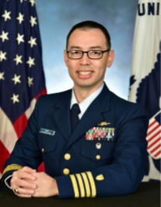
Command
Captain John Henry
Commanding Officer
CO
Mr. Steve Hudson
Executive Director
ED
YNCM Mario Valenzuela
Command Master Chief
CMC

Slide 13
Customer Service Division
CSD
Mr. Wess McElroy
Customer Service Division Chief
Vacant
CCB
LCDR Chris Holdren
Customer Care Branch
Dave Lynch
Advancements Branch
ADV
PPI
John James
Planning & Process Improvement Branch

Slide 14
Operations Division
OD
Mr. Jeff Bacon
Operations Division Chief
MAS
Jessica Wall
Military Accounts Support
SEP
CWO Morgan Ferrer
Separations
RAS
Kim Clennan
Retiree and Annuitant Services

Slide 15
Travel Management Office Division
CDR William Haywood
Travel Management Office Div. Chief
TMO
TVL
CWO Ricardo Camacho
Travel

Slide 16
Accounting Operations Division
AOD
Mrs. Nichol Nardozzi
Accounting Operations Division Chief
Megan Irvine
Financial Accounting & Reporting
FAR
IR
Rochelle Jackson
Internal Review

Slide 17
Legal Division
Mr. Bob Teetsel
Attorney
LGL

